Slide 1
Finally, A Way to Measure Frontend I/O Performance
Christopher Zimmer
Saurabh Gupta
Veronica G. Vergara Larrea

Slide 2
Titan and Spider II

Slide 3
Current Logging Points
DDN Stats
BRW Stats
Job Stats

Slide 4
Current Logging Points
DDN Stats
????
BRW Stats

Slide 5
Front End I/O
I/O Routers
  Service Nodes
  Gemini NIC
  Infiniband HCA
Titan contains
  440 I/O Routers
    8 for Meta-Data
    432 for Data

Slide 6
Why is this important?
There are I/O slow-downs and sources of variation that occur on the Gemini side that are invisible to our backend logging tools
Titan uses Fine-Grained Routing
  This means
    Routing is broken into 36 LNETS
    Across 12 partitions on Titan
    Each partition contains ~1557 nodes and 36 I/O routers
      Oversubscription is trivial

Slide 7
I/O Router Congestion Daemon
Daemon on I/O Routers
  Sampling Gemini stats on compute nodes
    May negatively impact applications due to kernel calls
    Scheduling invocations
    We try very hard to reduce sources of latency on compute nodes
    Visual interface using Splunk
I/O Routers run primarily Lustre LNET client
    Memory bound
    Extra headroom for lightweight sampling daemon

Slide 8
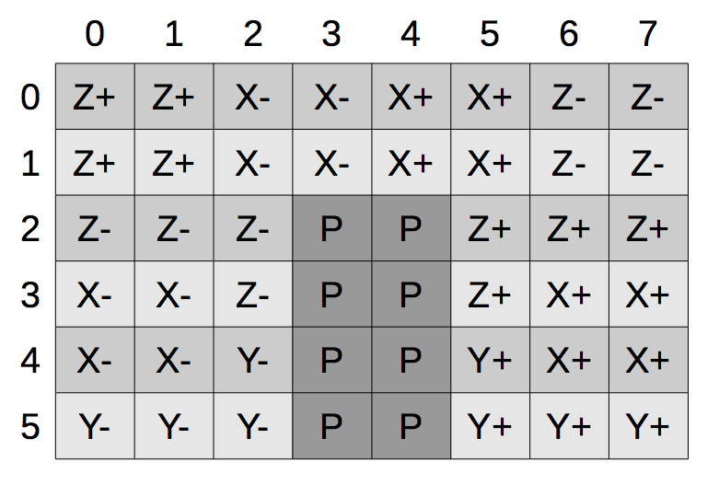
Gemini Stats
Gemini Routers
  Composed of 48 Tiles
    8 +X 8 –X
    8 +Z 8 -Z
    4 +Y 4 –Y
    8 Host Side
We only care about the host side congestion
  INQ Congestion (Read Traffic)
  OUTQ Congestion (Write Traffic)
Source “Introduction to the Cray XK7” by Jeff Larkin

Slide 9
Congestion Stats on I/O Routers
INQ/OUTQ Congestion Scales linearly with I/O bandwidth
INQ Congestion
  .84 P-Correlation with read bandwidth
Additional congestion can occur
  After exiting I/O router into Gemini
    This reduces correlation

Slide 10
Congestion Stats on I/O Routers
OutQ Congestion
  .94 P-Correlation with Write Bandwidth
  Write traffic
    Dominates performance
      Checkpoint / simulation outputs
    Titan writes more data than reads

Slide 11
Deployment to Chester
First pass deployment
  Verify no impact to applications or I/O performance
  I/O Test harness evaluation
    GTC
    Hacc-IO
    IOR

Slide 12
Deployment to Titan
Push to 432 I/O Routers
Splunk data ingestion increased but was able to keep up
Generated Splunk visualization dashboards to enable real-time tracking

Slide 13
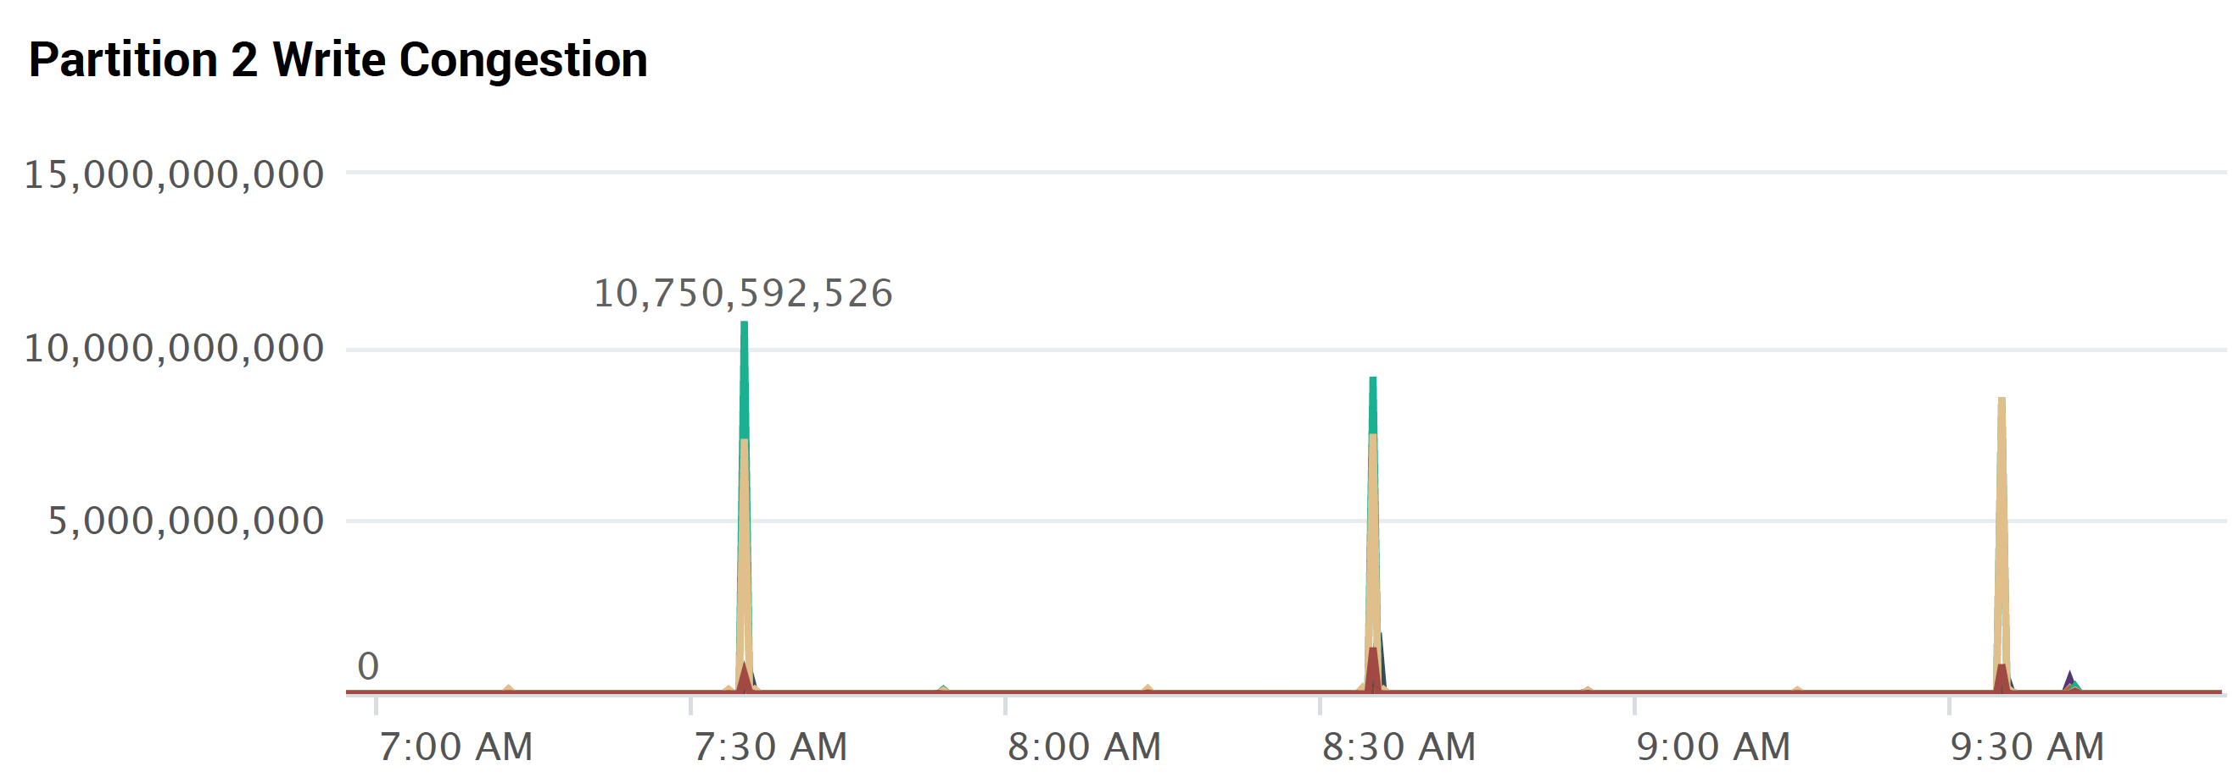
Splunk Dashboards
Use FGR Partitions
  12 Graphs
  Time-series congestion input
  18 Router pairs per graph

Slide 14
Performance Event on Chester
GTC Runs for Darshan
  Experienced 6000% performance decrease
  I/O portion of application was taking minutes

Slide 15
Performance Event on Chester Cont.
A) Able to witness this as it happened due to real-time tracking
B) Highlighted the need for additional data
  In a production workload this could have simply indicated
    Abundant small files being written over an extended period of time

Slide 16
Next Steps
Performance event highlighted areas of improvement
  How could we pin-point sources of degradation from an I/O Router?
LNET uses credits to exchange data
  IORCD is physically located with the LNET Router client

Slide 17
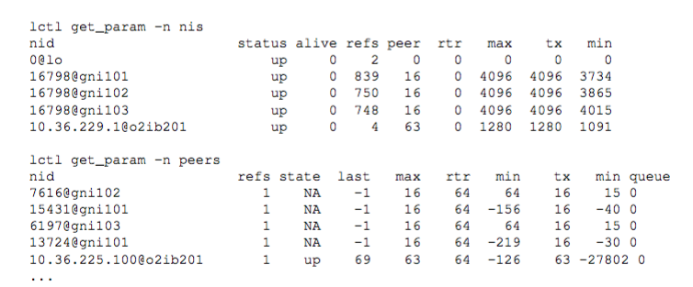
LNET Credits

Slide 18
We have some options
NIS Credits
  Inexpensive sampling
  Identify credit starvation that leads to extended congestion
  Pin-point network interface degradations occur on.
Peer Credits
  Lots of data to track
  Identify per-peer credit depletion
  Pin-point specific devices in parallel file system misbehaving in real-time

Slide 19
Ultimate Goals
Complete end-to-end real-time performance monitoring
  Enable precise and timely identification of problem points
High level services
  I/O library ADIOS/BPIO
    Avoid over-provisioned routers
    Using peer credits improve I/O timing to adjacent job avoid geometric digression

Slide 20
Conclusion
New I/O performance monitoring daemon
  Provides insight into I/O bottlenecks within Gemini
  Previous tools performed on backend storage
  Light weight / No performance impacts
  Real-time feedback using Guide Dashboards

Slide 21
Thank you!

