Slide 1
Novel Approaches to HPC User Engagement
Clair Barrass and David Henty

Slide 2
Funding
Thanks to
ARCHER project
PRACE via the EU’s Horizon 2020 Research and Innovation Programme (2014-2020) under grant agreements 653838 and 730913.

Slide 3
Novel approaches to HPC user engagement
Outreach
Driving Test
Training
Impact
Notes:
Looking at HPC user engagement from the point of view of ‘users’ including potential future users –
how we engage everyone from school children at Science Fairs and school visits,
on to novice HPC users dipping their toes into Unix and MPI, or even just trying to figure out if HPC is relevant for them,
to getting new users up, running and confident, developing user skills
and helping advanced experienced users get the best from HPC
right through to listening to the feedback from all of these ‘users’ and using that to develop our forward plan to work out what we can do to further enhance their experiences.

Slide 4
Outreach
Notes:
We have a very active Outreach team who travel to several UK Science Fairs each year,
including the Edinburgh International Science Festival – one of the worlds first and most successful fairs,
as well as the UK “Big Bang Fair” in Birmingham,
New Scientist Live, in London
smaller science fairs such as ‘Bang Goes the Borders’,
as well as school visits
and providing materials which can be used by other interested parents, school staff and HPC centres
to get our future ‘users’ informed about and engaged with the possibilities of HPC.

Slide 5
Outreach
Wee Archie
Build your own Supercomputer app
Champions
Image competition and calendar
Notes:
We have a wide range of different hands-on Demonstrations which we can take to our Outreach activities.

Slide 6
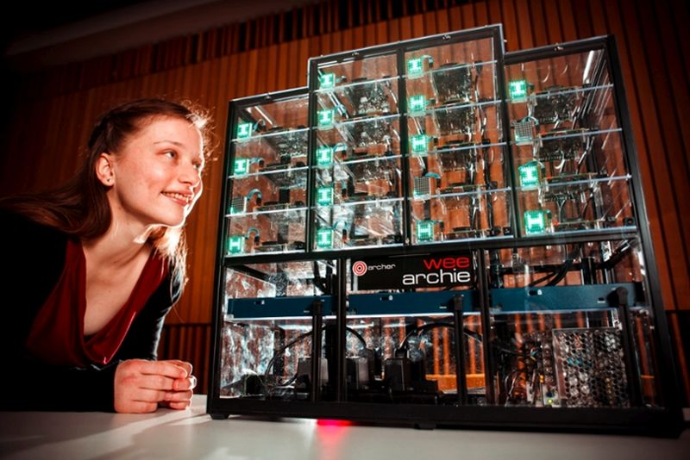
Wee ARCHIE
Notes:
We would love to be able to let everyone have a go on ARCHER and to see it in action, but whilst we love our Cray systems, Cray computers aren’t terribly portable!
Whilst we are aware that even a modern laptop or mobile phone is a parallel system, the underlying hardware and software is so deeply hidden that the parallelism is hard to demonstrate.
So we built a supercomputer from Raspberry Pis
The initial work in this area was done by The Oak Ridge Leadership Computing
Facility with Tiny Titan [4].
Inspired by this we decided to build our own extended version using the newer multi-core version of the
Raspberry Pi, designed to explain the architecture of
Wee ARCHIE is constructed from 18 Raspberry Pi 2’s, - 16 ‘compute nodes’, each with 4 cores, plus two ‘control and monitoring’ Pis
a network switch,
a power supply unit
and Ethernet cables.
LED matrix to show live operational metrics
in a custom-built case [5],

Slide 7
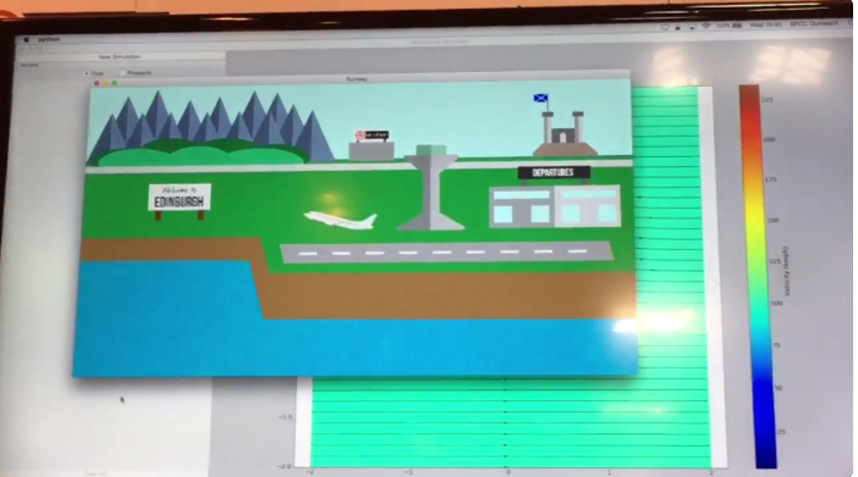
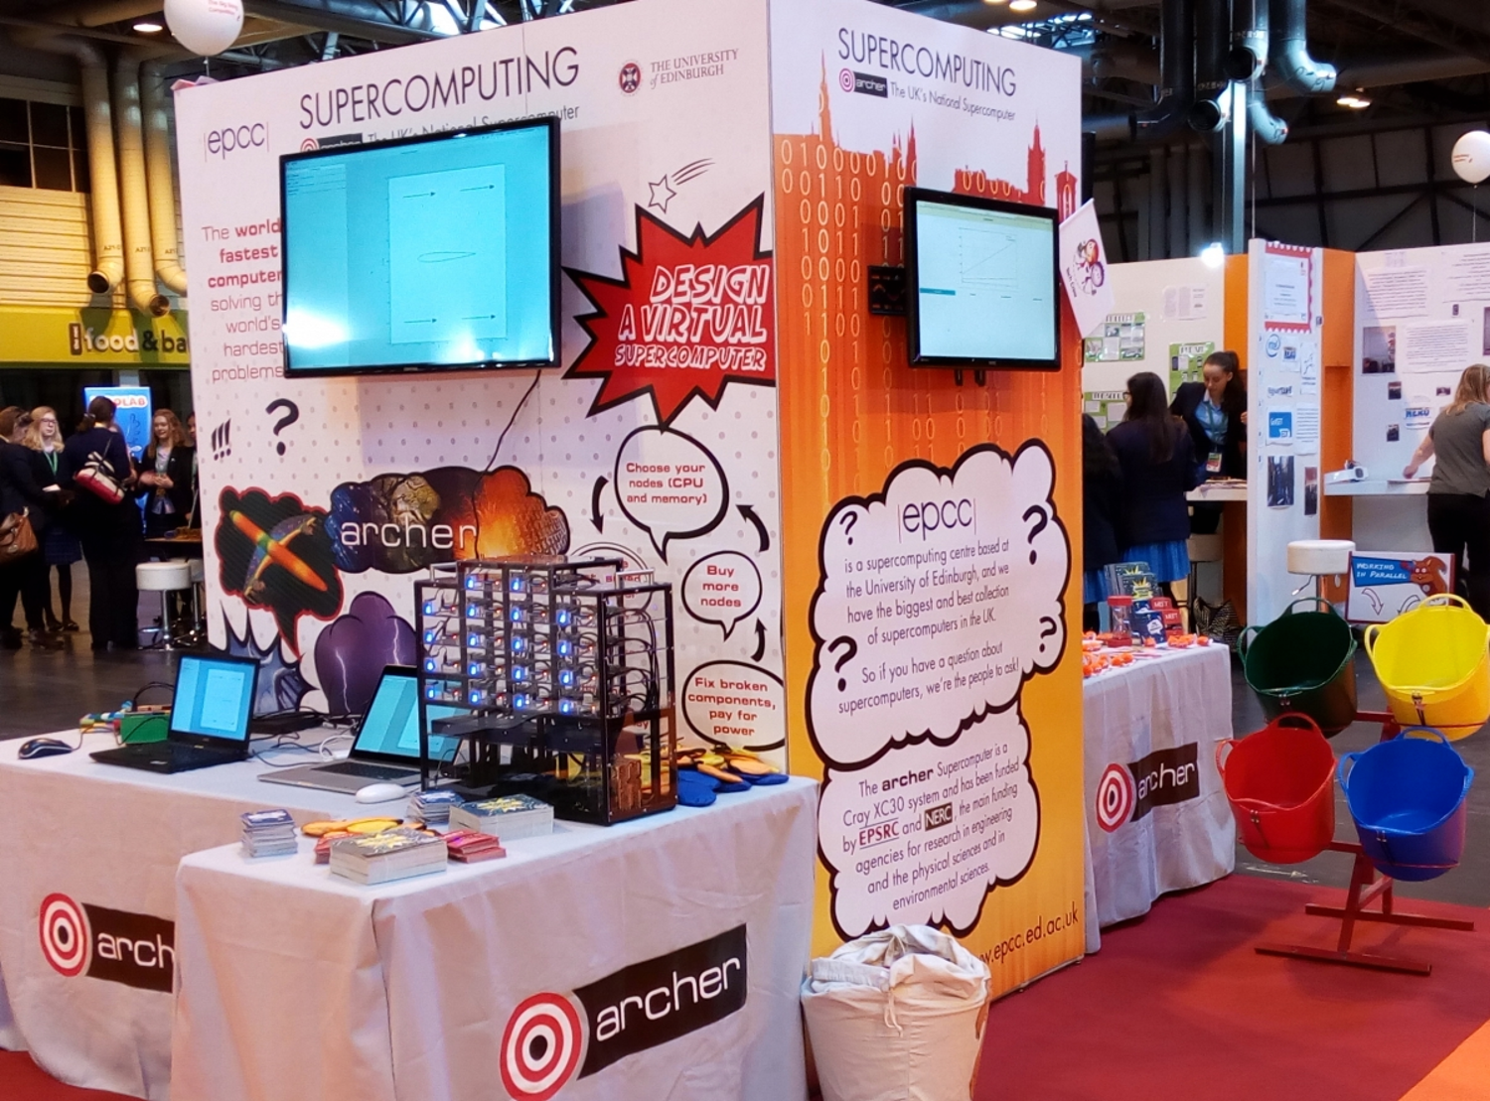
Wee ARCHIE
Notes:
Wee ARCHIE can run cut-down real-life simulations – we took codes that run on ARCHER and adapted them.
These include an airplane CFD demo to model airflow over a wing, computing all sorts of parameters that would be
crucial for flight.
Participants can then view their wing on a passenger aircraft, see how the easily the aircraft will take
off (or not!), and the overall range of the plane on a single tank of fuel.
By tweaking the wing parameters and re-simulating on Wee ARCHIE they can optimise the wing for specific aspects –
but as in real-life, it can be a trade-off between take-off performance and range.
Other demos include Dinosaur racing – where code to model dinosaur skeletons to look at how they move can be tweaked to produce a variety of body shapes, and then the different creations set to race against each other.
and a scaled-down molecular dynamics code running a simulation of pheromones in mouse urine.
they are all based on real simulations that run on ARCHER.
A more low-tech ‘simulation’ of HPC is our bean-Bag sorting activity.

Slide 8
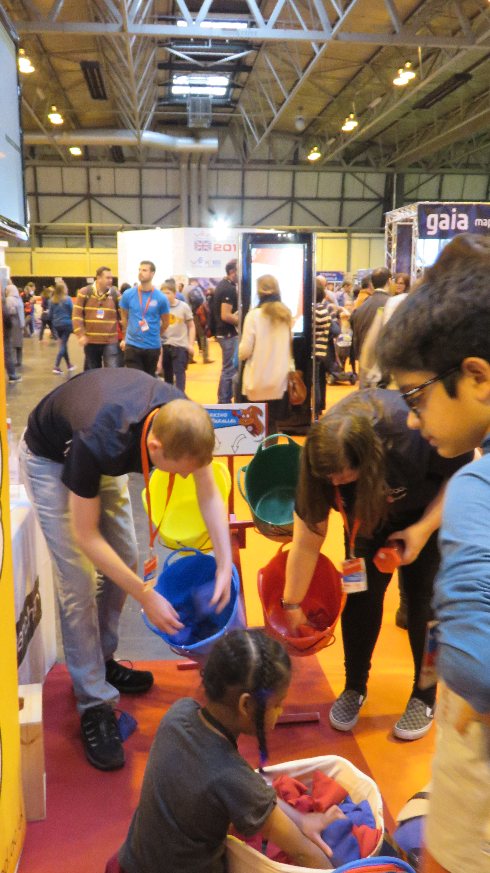
Bean-Bag Sorting
Notes:
Teams are timed, sorting bean bags by colour, by one person, by two, by teams of four, maybe even 8
Try out different work allocation methods such as each team member only picks up one colour of bag.
Looking at how too many people causes more hold-ups
Hugely popular and leads to real-life parallel performance speed-up graphs
Can clearly see when contention for the input leads to slow-down instead of parallel speed-up

Slide 9
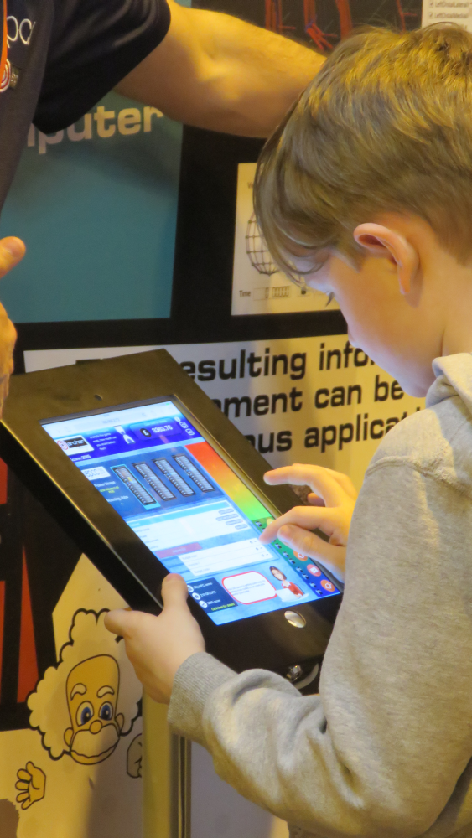
Build your own Supercomputer app
bit.ly/byo-hpc
Notes:
You can also become an “HPC centre manager” using our Build-Your-Own HPC app
This project was initially developed as part of the PRACE Summer of HPC 2015 [7].
a hands-on simulation which can be accessed by anyone, anywhere, anytime, online.
You are in charge of a supercomputer centre and you have to run lots of jobs on your machines,
Using your budget wisely to buy the best hardware for the job.
balancing its components against budget and power efficiency.
Although the game can be played just for fun,
designed to illustrate many fundamental concepts and constraints of a real system.
These include power efficiency,
terminology such as 'node', 'accelerator' and 'scalability', and
the fact that different simulations have varying optimal
hardware configurations.
can be run in a kiosk mode at a science fair
where each participant's time is limited to a few minutes with a competition leaderboard for jobs processed and money earned

Slide 10
Champions
Notes:
ARCHER Champions launched in March 2016
Champions networks are appearing linked to many different areas including HPC.
ARCHER Champions began in May 2016 with meetings held every 6 months since at different locations around the UK.
Principal focus on providing local support and advice on appropriate HPC. Champions will know about routes to access and application procedures for ARCHER
So users can be directed to best resource, be that local, regional or National i.e. ARCHER
The aim is to provide an informal network of contacts around the UK who are familiar with all aspects of the ARCHER service.
being able to talk to someone in their own institution is better than making more formal enquiries via the ARCHER helpdesk.
Also building close links to the Regional Tier-2 Champions with many Champions involved in both so able to provide best guidance, direction and support regardless of level of user.

Slide 11
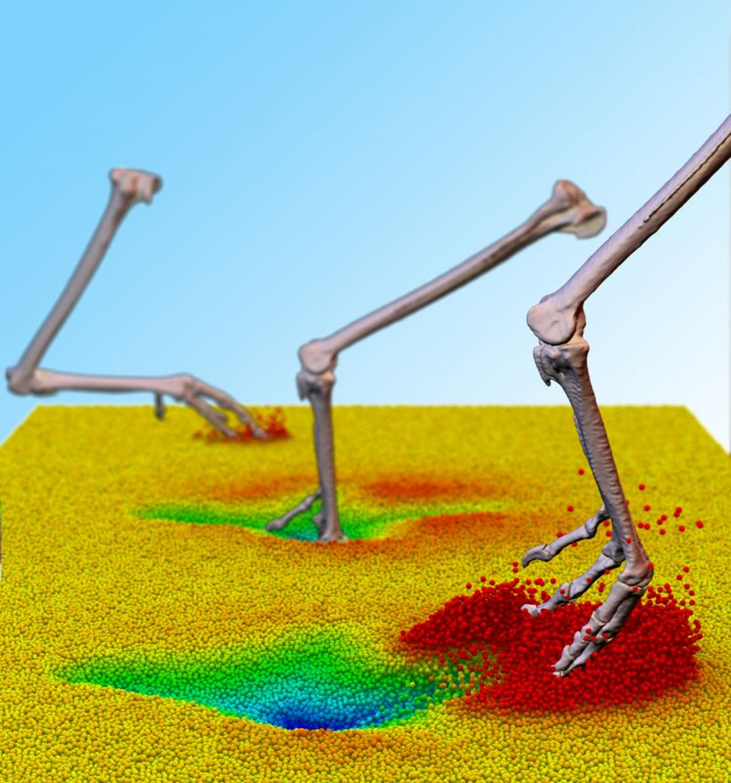
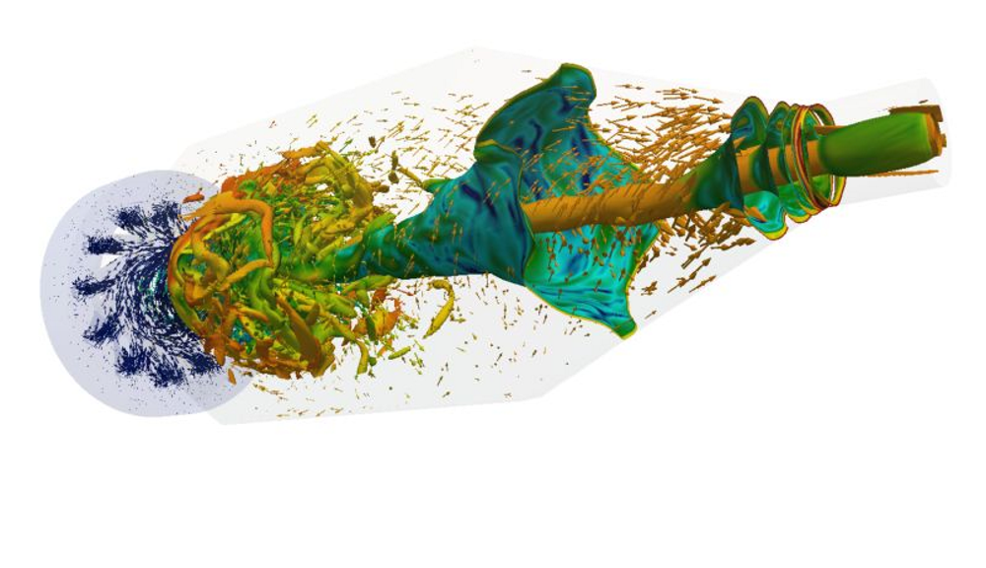
Image competition and calendar
Winning image 2014 : Dr Pedro J. Sáenz, University of Edinburgh Institute for Materials and Processes.
Winning image 2016 : Dr Peter Falkingham, Natural Sciences & Psychology, Liverpool John Moores University.
Winning image 2015 : Mr Ivan Langella, University of Cambridge, Department of Engineering.
Notes:
A novel method to raise the public profile of HPC and inform a wide audience about what goes on, on ARCHER has been our
ARCHER Image Competition [14] which has run very successfully for three years now.
ARCHER submit images based on their work on ARCHER which demonstrate “ARCHER Enabling Research”.
The winning entry is awarded a cash prize of £250 and is invited to write up a Case Study of their research
over 30 entries each year, all of a very high standard entries are displayed in galleries on our ARCHER Web site
The top twelve entries each year published as a calendar [16] for the past three year.
In 2016, 600 copies were distributed to a wide variety of destinations
including ARCHER PIs and users, University personnel both here in Edinburgh and around the UK and Europe,
science centres, schools and many other individuals and organisations who have an interest in ARCHER and UK HPC.
providing a library of attractive images with accompanying text describing the underlying science.
authors and their institution benefit from raised profile and impact,
something which is increasingly important in obtaining funding in the UK.

Slide 12
Driving Test
Notes:
The ARCHER driving test launched in February 2015.
novice users were attending our Hands-on Introduction to HPC training course,
they were given access to an ARCHER guest user account,
once the course ended they no longer had any access to ARCHER, or possibly any HPC system at all,
To practice what they had just learned or try out ideas on how to apply their new knowledge to their own research areas.
a 'test' as a gateway to providing low-barrier access may seem counter-intuitive,
designed to be extremely easy to pass for anyone who has only the most basic knowledge about HPC.

Slide 13
Driving Test
Notes:
The questions are designed to be simple
They are asking simple questions about the basics of HPC such as file systems, IO, running jobs, compiling
Avoids the potential deluge of people with no real interest or any understanding just randomly clicking a “sign-me-up” button
But the mere fact of having completed the test assigns some ‘value’ to the reward of time on the machine

Slide 14
Driving Test
Notes:
We then developed a bank of questions, sub-divided into different topic areas:
Compiling, Hardware, I/O, PBS job scheduler, Programming, Running jobs
From this bank of over 100 questions, a quiz comprising 20 questions is presented to each site visitor
all the introductory materials are readily available online.
We video-recorded a run of the Hands-on Introduction to HPC training course on ARCHER YouTube channel
made sure a full set of the course materials, including the PowerPoint, practical task handouts and resource files all available
This ensured that anyone could access the materials to either walk through
independently or to act as a refresher for the face-to-face training.
Almost 90% (259/292) of people attempting the Driving Test have achieved a pass,
though some of them have taken two or more attempts.
All but a handful of who don’t pass have not even attempted most of the questions which suggests they stumbled across the page and had a look, but really were not motivated to complete the test.
Also hopefully makes getting started less daunting as they are reassured that they ‘know what they are doing’ by the time they have the sign-in details.

Slide 15
Driving Test
Notes:
Not only has taking the test been popular, with almost 200 accounts set up in the first two years,
but a very high percentage of the accounts have been actively used.

Slide 16
Driving Test
Notes:
The usage pattern shows that many of the users who get access to ARCHER via the test are running predominantly small jobs – presumably getting a feel for how to submit a job, running against small samples of data, but there are also a significant proportion running bigger scale jobs although when compared against the total user population of ARCHER, there are unsurprisingly few able to run jobs which require large amounts of CPU to run – because the Driving Test only awards a very limited budget.

Slide 17
Driving Test
Notes:
Moreover, we can also clearly see that the Driving Test users are not just running one or two test jobs – the modal value is in excess of 200 jobs per user, clearly demonstrating that it is enabling a real opportunity to run whole series of jobs.

Slide 18
Training
Notes:
Training is absolutely essential go getting new users onto HPC and developing the necessary skills for those users to make effective use.
Much of our training is traditional, face-to-face, classroom based training and we have an extensive curriculum of courses on offer.

Slide 19
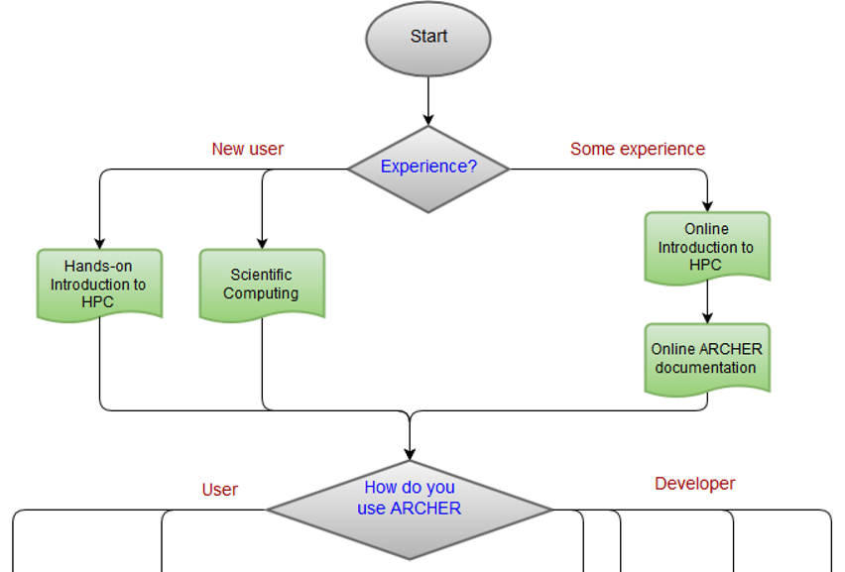
Training
Notes:
Face to face teaching may not be novel,
But providing a route-map through the range of options helps users to select appropriate courses
And helps guide them from novice to expert user

Slide 20
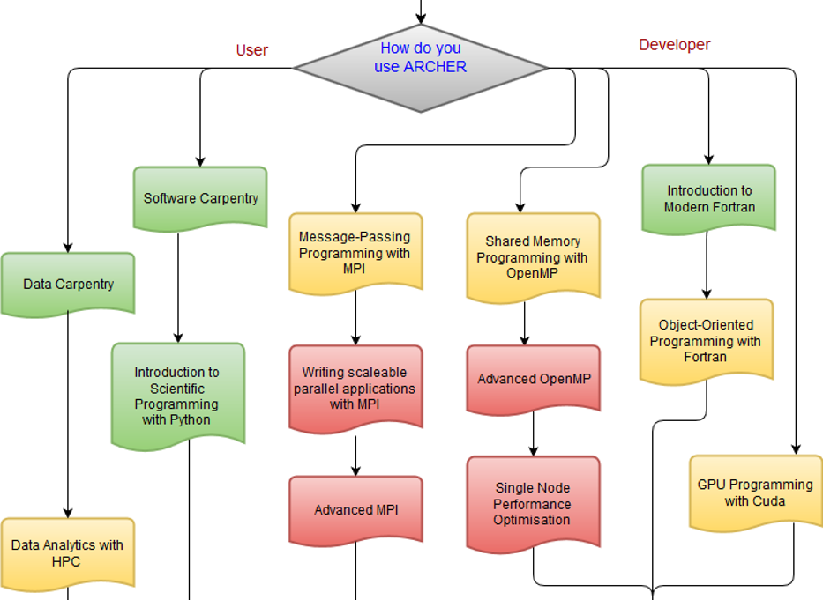
Training
Notes:
we also do intensive workshops where the proportion of tutors to attendees is much higher
Such as our annual “Porting and Optimisation workshop”
Attendees bring a specific code to the workshop where one of our team work with them over a whole day to help them port the code to ARCHER and/or look at ways of improving how their code runs. By getting information about the code, and matching the EPCC team member with appropriate experience and expertise with the delegates, we are able to maximise the benefit which helps not just that participant but the whole ARCHER community, when more effective use of the machine can be enabled.

Slide 21
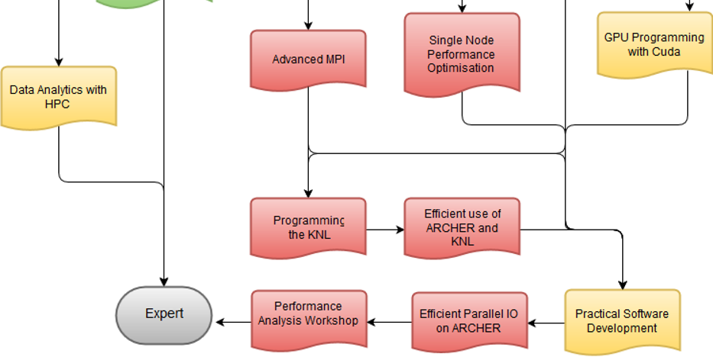
Training

Slide 22
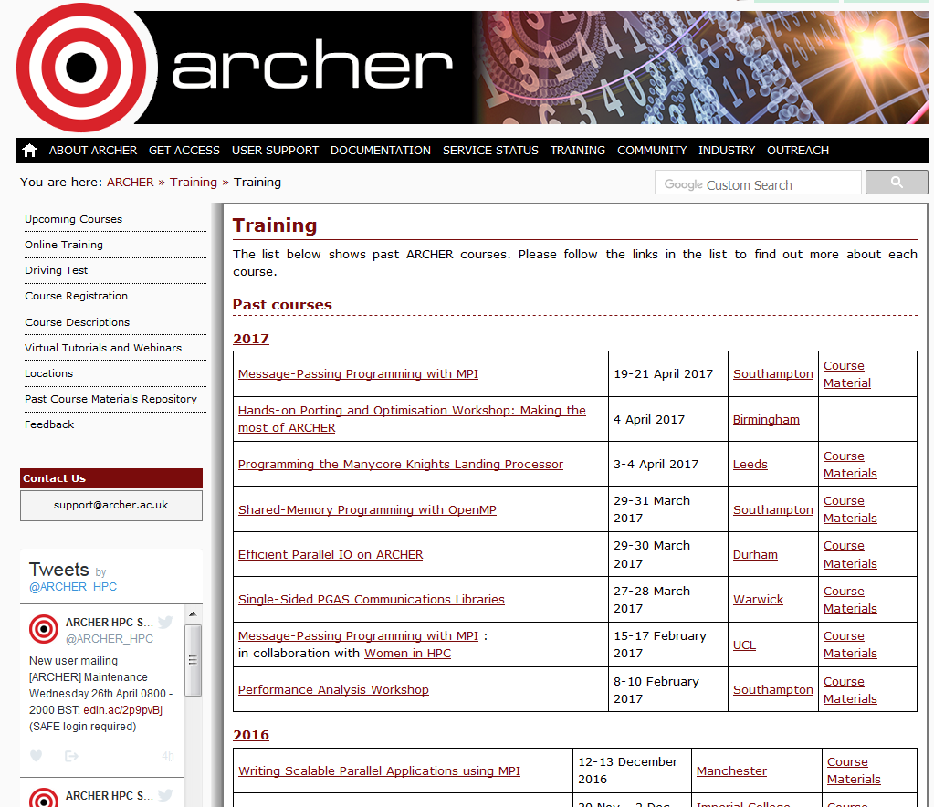
Training
Notes:
All previous runs of all our face to face courses are archived online so the lecture slides, course materials, practical handouts and solutions are all available for anyone to use to refresh their memory of a course they attended, or to use as self-teaching materials if they are unable to attend a course.

Slide 23
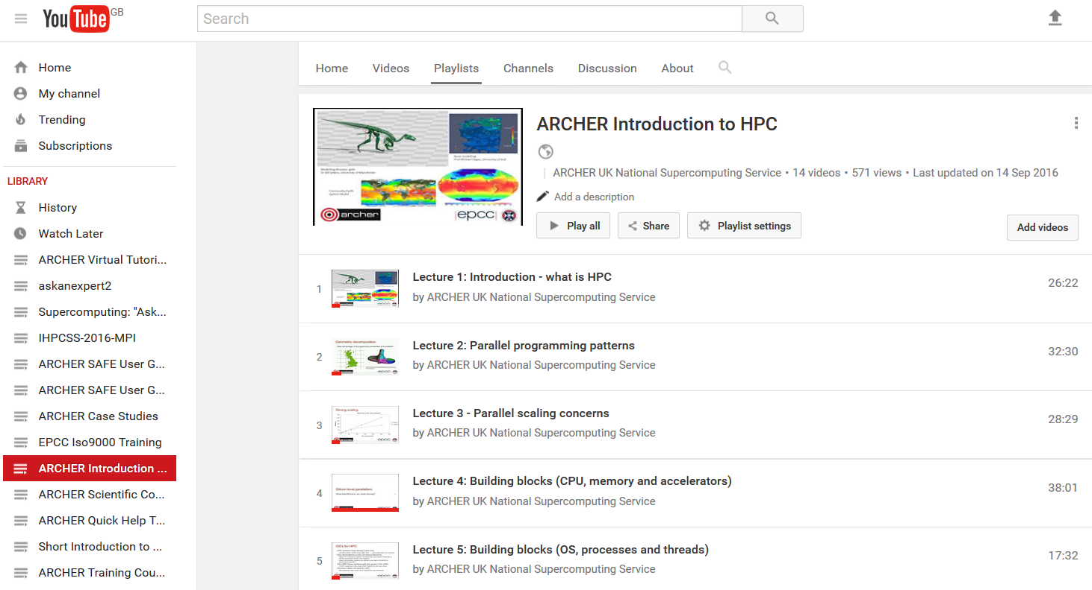
Training
Notes:
In addition, some of our core courses have been videoed and are available via our YouTube channel, featuring not only the usual course materials but also the video of a live presenter working through the lessons in a classroom.

Slide 24
Training
Notes:
As well as training to use HPC, we provide training for using the SAFE which is our web-based management system for managing user accounts and projects for ARCHER. Getting on to SAFE and using it are a vital first step to getting a machine account on ARCHER.
SAFE user guide and videos provide help for those just getting started, signing up for an account on ARCHER and administering their account and their project.
Individual tasks have been screen-cast as a walk-through so even those for whom English is not their first language can follow along. Each video is very short – many are less than a minute long – and focused on just one task.

Slide 25
Impact
Notes:
Getting user feedback on our Training activities and resources has always been important to us and we emphasise it’s importance in improving our existing courses and planning what we offer in the future.
Positive feedback, and evidence that we have responded to feedback and suggestions, is also considered important in maintaining funding for our training activities.

Slide 26
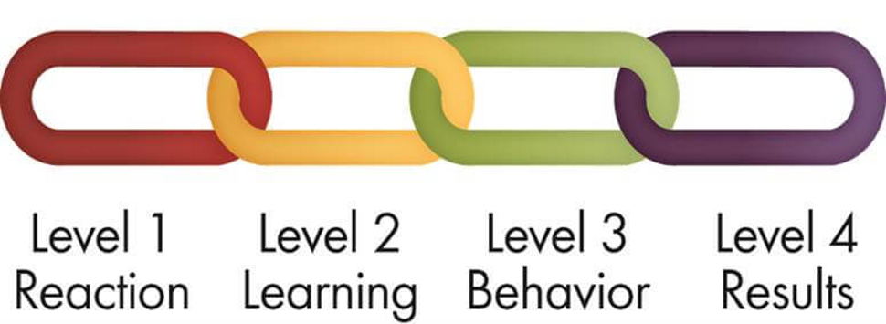
Impact
Kirkpatrick Model
Notes:
To evaluate the Impact of our training we have adopted the Kirkpatrick, 4-stage model of impact

Slide 27
Impact
Notes:
During face-to-face training, especially on introductory courses such as “Software Carpentry”, we ask for quick feedback on how the attendees feel the course is going e.g. in terms of depth of coverage of material, pace of delivery via hands up or traffic-lighting post-its where they stick a green post it on their laptop if all is well, and a red if they are stuck or struggling to keep up.

Slide 28
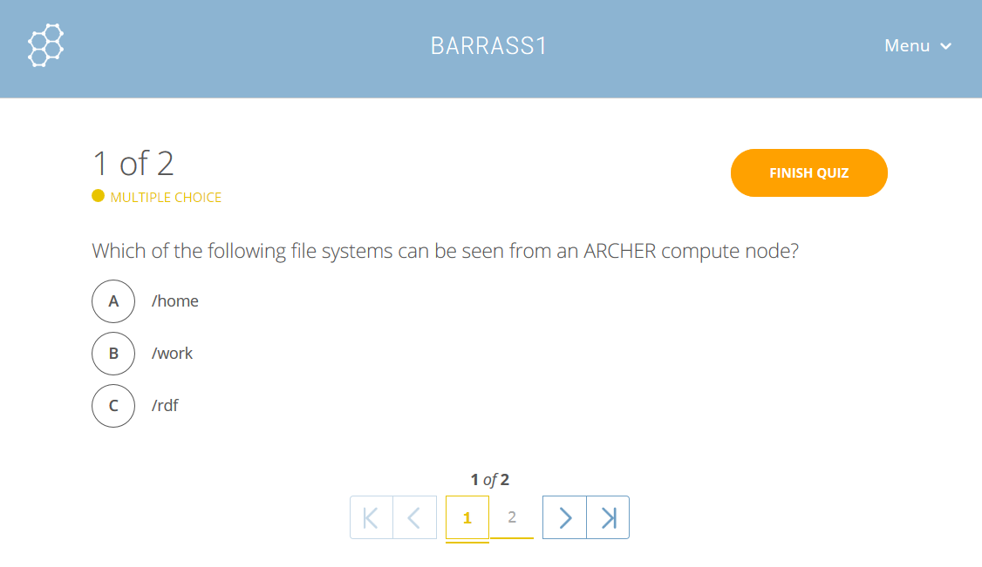
Impact
Notes:
We have also made use of mini-quizzes, where two or three quick multi-choice quiz questions are presented on the topics just covered to gauge how well they have grasped it and reveal any gaps or misunderstandings. We have used the Socrative tool [31] for this which is particularly easy to use – it can be open in a browser window or a smart phone app whilst the course is ongoing. The responses are instant and can be anonymous, which encourages full participation.

Slide 29
Impact
Notes:
At the end of each course we ask participants to complete a short feedback survey.
The initial feedback is very positive, with most rating the training as Very Good or Excellent
Other questions cover Relevance of topics, pace and style of delivery, the materials used, the location.
This end of course feedback corresponds to Kirpatrick Level 2
And informs us on how a particular course has been received

Slide 30
Impact
Notes:
In order to gauge the longer term impact of our training, we conduct Follow-up feedback questionnaires
Everyone who attended a course in the preceding 3 – 9 months is asked to feed back on who they have used and benefitted from the training.
Response rate of around 10% of all those asked – again it is emphasised that this feedback will actively shape our future course offerings so it is in their interest to tell us what they want so we can offer it.
Some people lost to follow-up due to having changed email address…

Slide 31
Impact
Notes:
By reviewing how people view the training, looking back after having some time to apply it to their work, we can see the longer term impact on their understanding and behaviour
Level 3 Kirkpatrick.
Again, our feedback shows a strong positive feeling that the training increased their understanding

Slide 32
Impact
Notes:
The vast majority of respondents felt that the training had increased their productivity in the long term.
Difficult to quantify from an online quiz but the subjective feeling that comes through from our feedback is that people feel it has improved productivity.
Other questions ask about how it has improved code performance and helped with grant submissions
We also get information about who they have shared their training with – colleagues, students
And list of suggestions for enhancements to the course and new courses they would like us to offer.
We have been able to take some of these suggestions on board already and for example we are looking at adding a C++ for HPC course to our syllabus.

Slide 33
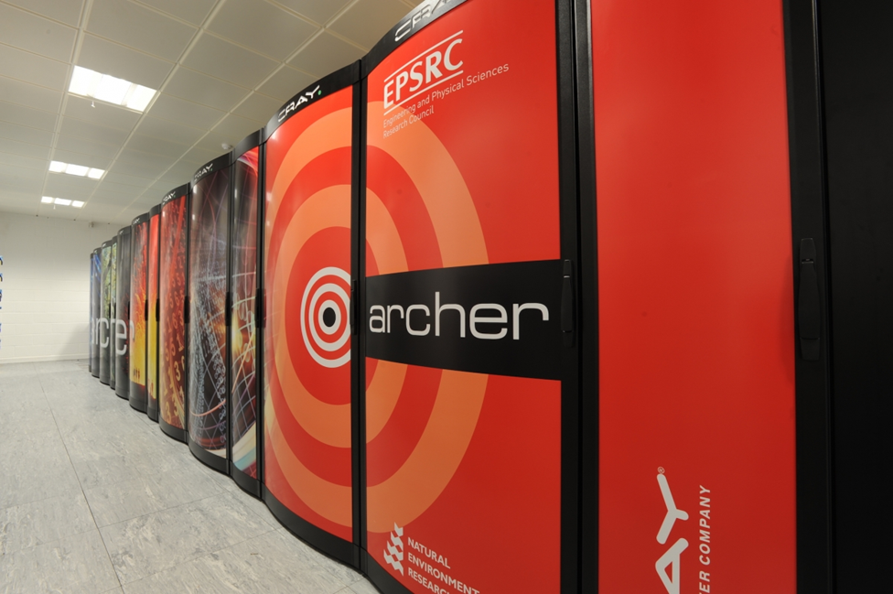
Novel approaches to HPC user engagement
Outreach
Driving Test
Training
Impact
Notes:
Conclusion
Looked at the four key areas we are focusing on for user engagement
Engaging ‘users’ from school through to experienced HPC experts
Successful, two-way dialogue with feedback helping to drive and direct our forward plans
I hope that you have found some of these ideas interesting an informative, and maybe that one or two that might inspire you to try something similar.
Very happy to chat and point you to some of our resources.

Slide 34
Notes:
I hope that you have found some of these ideas interesting an informative, and maybe that one or two of you might be inspired to try something similar.
Very happy to chat and point you to some of our resources.

